Slide 1


Prediction of COPD using machine
learning technique
R.M.D ENGINEERING COLLEGE
(An Autonomous Institution)
Department of Electronics & Communication Engineering
Team Members
111518106173 : Vignesh R
111518106177 : Vinod Kumar P
11519106150 : SIva Kumar G
Project Guide
Name: Mr. Jaiganesh B
Designation: Assistant Professor

Slide 2
R.M.D ENGINEERING COLLEGE
(An Autonomous Institution)
Department of Electronics & Communication Engineering
OBJECTIVE
To find the most appropriate machine learning approach for COPD prediction which is both computationally efficient and accurate.
To translate the use of a novel, quantitative lung ultrasound surface wave elastography technique (LUSWE) into the bedside assessment of pulmonary edema in patients admitted with acute congestive heart failure.

Slide 3
R.M.D ENGINEERING COLLEGE
(An Autonomous Institution)
Department of Electronics & Communication Engineering
ABSTRACT
Ultrasound insonation of lungs that are dense with extravascular lung water (EVLW) produces characteristic reverberation artifacts termed B-lines. The number of B-lines present demonstrates reasonable correlation to the amount of EVLW.
However, analysis of B-line artifacts generated by this modality is semi-quantitative relying on visual interpretation, and as a result, can be subject to inter-observer variability. The purpose of this study was to translate the use of a novel, quantitative lung ultrasound surface wave elastography technique (LUSWE) into the bedside assessment of pulmonary edema in patients admitted with acute congestive heart failure.
The aim is to predict machine learning based techniques for pulmonary disease prediction results in best accuracy. The analysis of dataset by supervised machine learning technique(SMLT) to capture several information’s like, variable identification, uni-variate analysis, bi-variate and multi-variate analysis, missing value treatments and analyze the data validation, data cleaning/preparing and data visualization will be done on the entire given dataset.

Slide 4
R.M.D ENGINEERING COLLEGE
(An Autonomous Institution)
Department of Electronics & Communication Engineering
LITERATURE SURVEY
S.No | Title of the Paper | Title of the Journal | Year of Publication | Discussions
1 | Lung Cancer Prediction using Data Mining Techniques | IEEE | 2019 | Features and Scope
2 | Lung Disease Prediction using Image Processing & CNN Algorithm | IEEE | 2020 | Function
3 | Detection of Different stages of COPD Patients | IEEE | 2021 | Uses and importance
4 | Prediction of COPD severity based on clinical data | IEEE | 2022 | Functions and characteristics

Slide 5
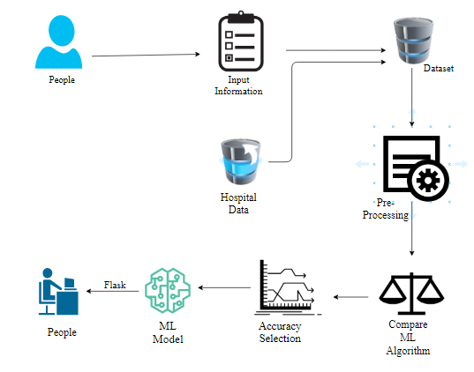
R.M.D ENGINEERING COLLEGE
(An Autonomous Institution)
Department of Electronics & Communication Engineering
SYSTEM ARCHITECTURE

Slide 6
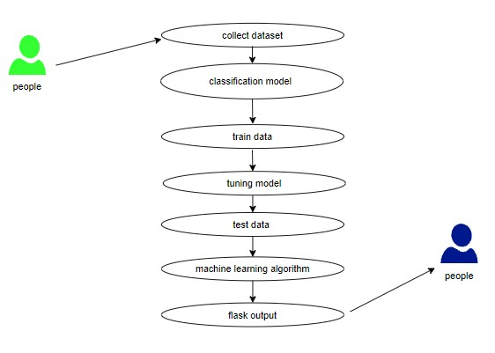
R.M.D ENGINEERING COLLEGE
(An Autonomous Institution)
Department of Electronics & Communication Engineering
USE CASE DIAGRAM

Slide 7
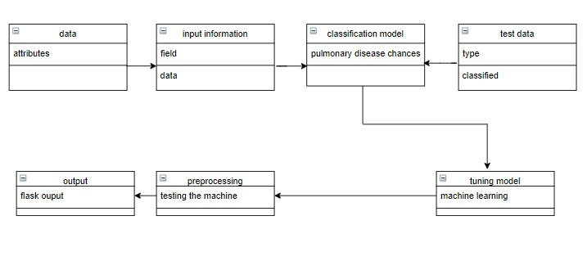
R.M.D ENGINEERING COLLEGE
(An Autonomous Institution)
Department of Electronics & Communication Engineering
CLASS DIAGRAM

Slide 8
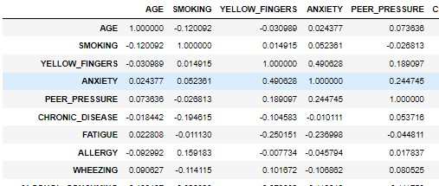
R.M.D ENGINEERING COLLEGE
(An Autonomous Institution)
Department of Electronics & Communication Engineering
RESULT
Data validation

Slide 9
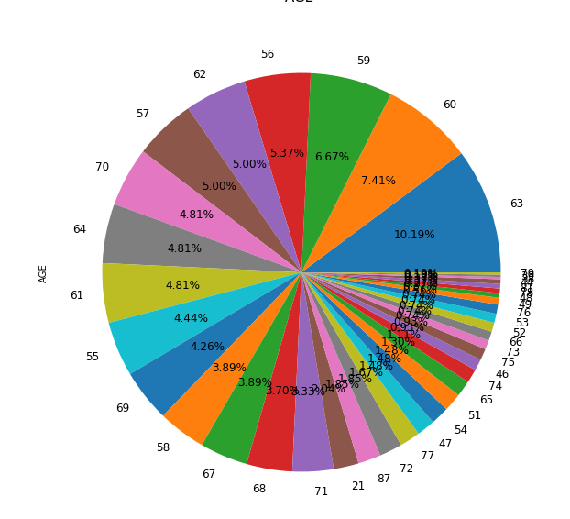
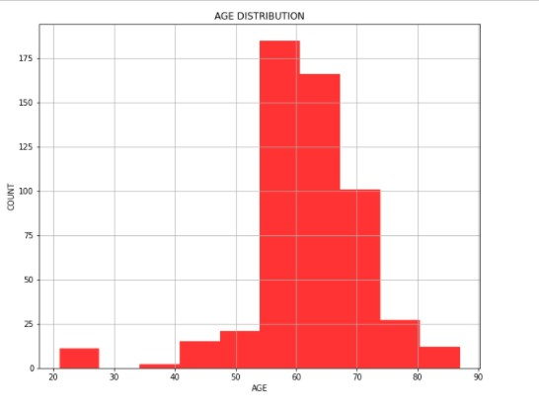
R.M.D ENGINEERING COLLEGE
(An Autonomous Institution)
Department of Electronics & Communication Engineering
RESULT
Plotting of data

Slide 10
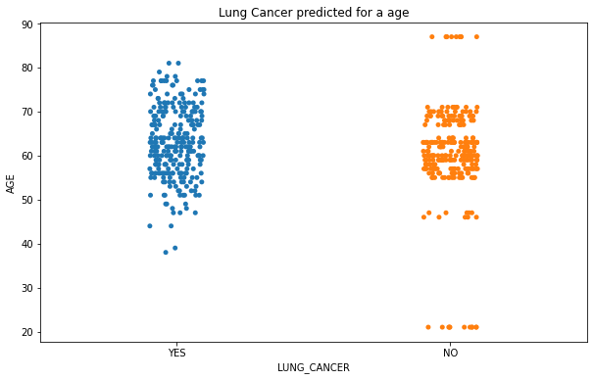
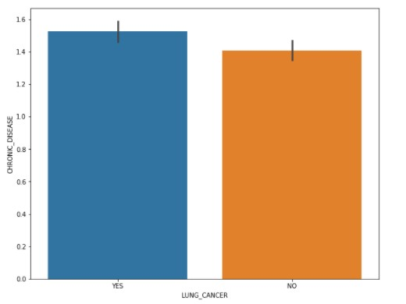
R.M.D ENGINEERING COLLEGE
(An Autonomous Institution)
Department of Electronics & Communication Engineering
Sub Plots

Slide 11
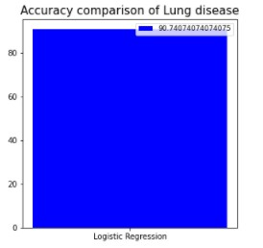
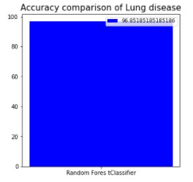

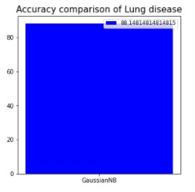
R.M.D ENGINEERING COLLEGE
(An Autonomous Institution)
Department of Electronics & Communication Engineering
Accuracy comparison of various Algorithms

Slide 12
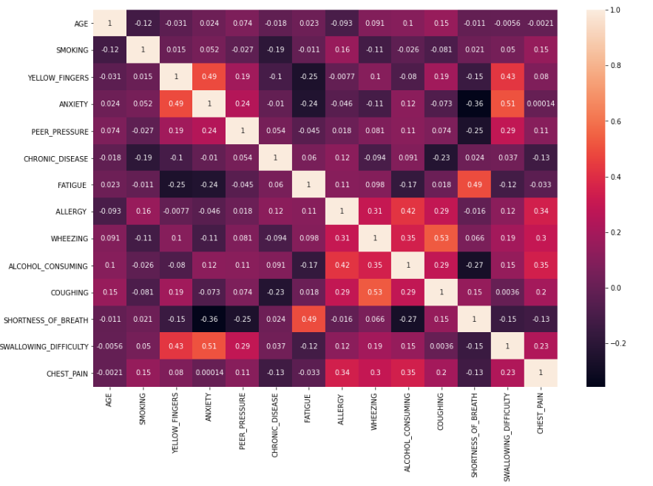
R.M.D ENGINEERING COLLEGE
(An Autonomous Institution)
Department of Electronics & Communication Engineering
Heat map of the data

Slide 13
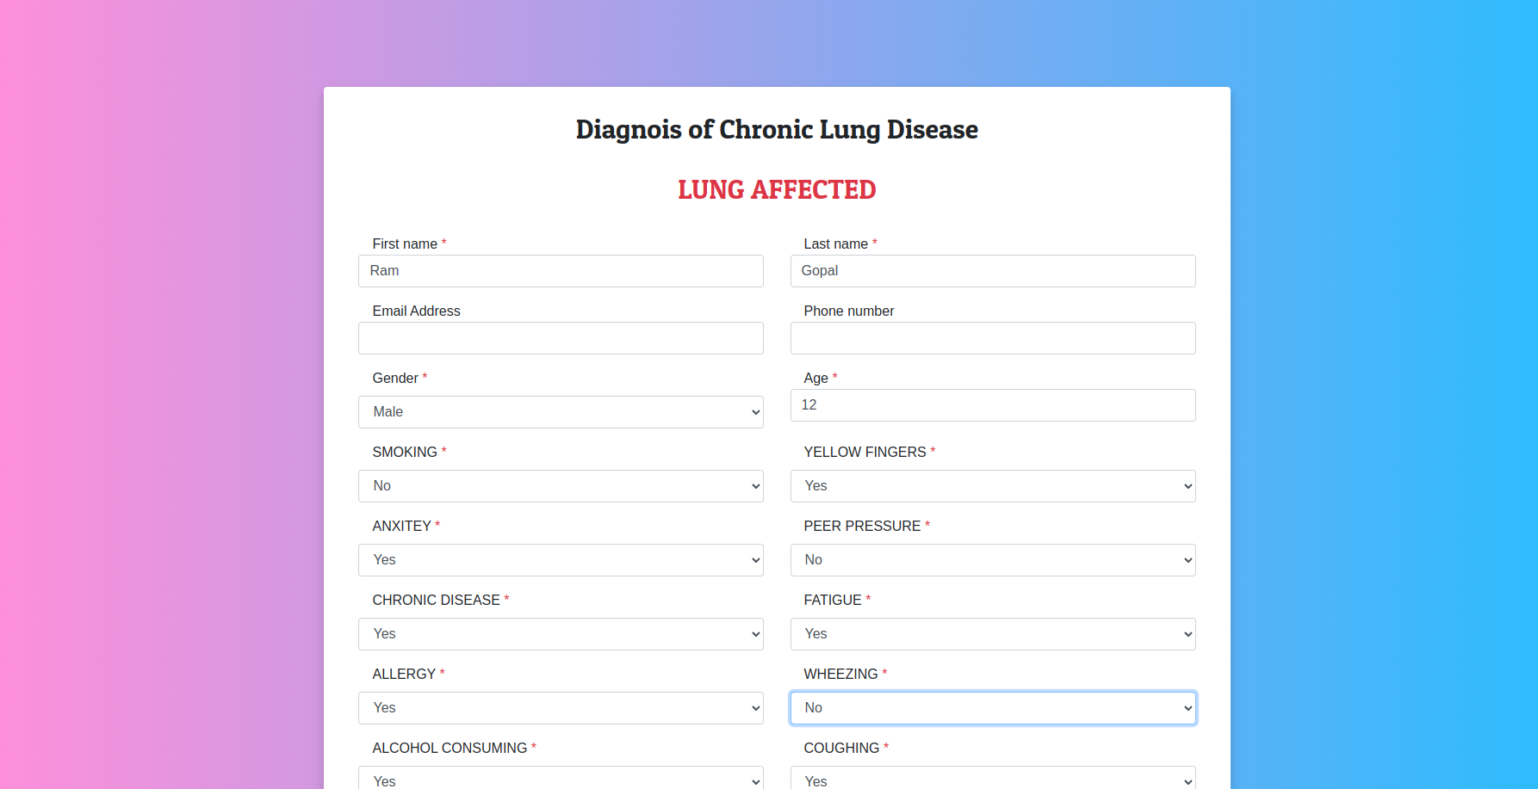
R.M.D ENGINEERING COLLEGE
(An Autonomous Institution)
Department of Electronics & Communication Engineering
FInal Output

Slide 14
R.M.D ENGINEERING COLLEGE
(An Autonomous Institution)
Department of Electronics & Communication Engineering
REFERENCES
M. H. Miglioranza et al., "Pulmonary congestion evaluated by lung ultrasound predicts decompensation in heart failure outpatients," Int J Cardiol, vol. 240, pp. 271-278, Aug 1 2017, doi: 10.1016/j.ijcard.2017.02.150.
E. Picano and P. A. Pellikka, "Ultrasound of extravascular lung water: a new standard for pulmonary congestion," Eur Heart J, vol. 37, no. 27, pp. 2097-104, Jul 14 2016, doi: 10.1093/eurheartj/ehw164
E. Picano and P. A. Pellikka, "Ultrasound of extravascular lung water: a new standard for pulmonary congestion," (in eng), Eur Heart J, Review vol. 37, no. 27, pp. 2097-104, Jul 14 2016, doi: 10.1093/eurheartj/ehw164.
L. Gargani et al., "Persistent pulmonary congestion before discharge predicts rehospitalization in heart failure: a lung ultrasound study," Cardiovasc Ultrasound, vol. 13, p. 40, Sep 4 2015, doi: 10.1186/s12947-015-0033-4
P. Enghard et al., "Simplified lung ultrasound protocol shows excellent prediction of extravascular lung water in ventilated intensive care patients," Critical Care, vol. 19, no. 1, p. 36, 2015.

Slide 15
R.M.D ENGINEERING COLLEGE
(An Autonomous Institution)
Department of Electronics & Communication Engineering
REFERENCES
Pivetta et al., "Lung Ultrasound-Implemented Diagnosis of Acute Decompensated Heart Failure in the ED: A SIMEU Multicenter Study," Chest, vol. 148, no. 1, pp. 202-210, Jul 2015, doi: 10.1378/chest.14-2608.
J. L. Martindale, V. E. Noble, and A. Liteplo, "Diagnosing pulmonary edema: lung ultrasound versus chest radiography," European Journal of Emergency Medicine, vol. 20, no. 5, pp. 356-360, 2013.
G. Volpicelli et al., "International evidence-based recommendations for point-of-care lung ultrasound," Intensive care medicine, vol. 38, no. 4, pp. 577-591, 2012.
G. Soldati, V. Giunta, S. Sher, F. Melosi, and C. Dini, "“Synthetic” comets: a new look at lung sonography," Ultrasound in Medicine and Biology, vol. 37, no. 11, pp. 1762-1770, 2011.
D. Lichtenstein and G. Meziere, "A lung ultrasound sign allowing bedside distinction between pulmonary edema and COPD: the comet-tail artifact," Intensive care medicine, vol. 24, no. 12, pp. 1331-1334, 1998.

